Slide 1

Denoising methods for character recognition
VE556, Image Processing, project presentation
Maxence Vandendorpe, Hugo Vanhille
16/12/2022

Slide 2
Contents
Background
OCR
Denoising Methods
Project Goal
Dataset
Methods
Noise
Spatial filters
Transform domain filtering
Results
Performance metrics
Character recognition with NN
Future work
Improvements

Slide 3
Background

Slide 4
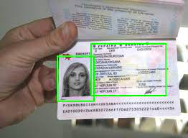

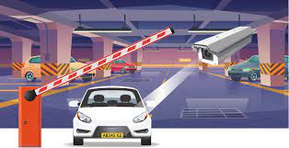
Optical character recognition
Passport recognition
Automatic number plate recognition
Converting handwritten text to digital text

Slide 5
Denoising
“With the explosion in the number of digital images taken every day, the demand for more accurate and visually pleasing images is increasing.” Linwei Fan [2]
Related work : Raghunath Dey [3]. Provides a summarize of different procedures and aspects of preprocessing for OCR

Slide 6
Project’s goals
Implementation
Implements severals methods of denoising on python
Comparison
Compare denosing methods on a set of images
Characters recognition
Apply character recognition to denoised images with DNN

Slide 7



Chars 74K Dataset
Characters from natural images
Hand drawn characters
synthesised characters from computer fonts

Slide 8
Methods

Slide 9
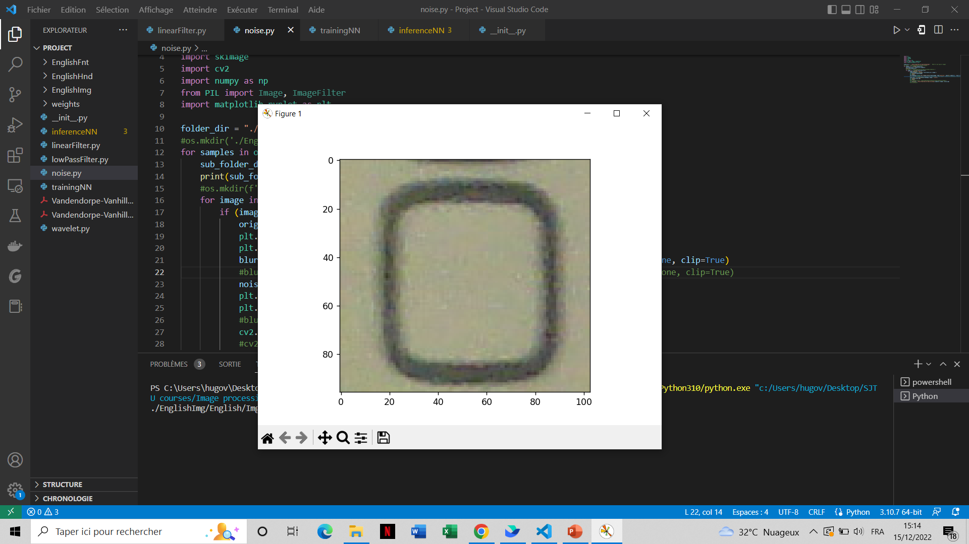
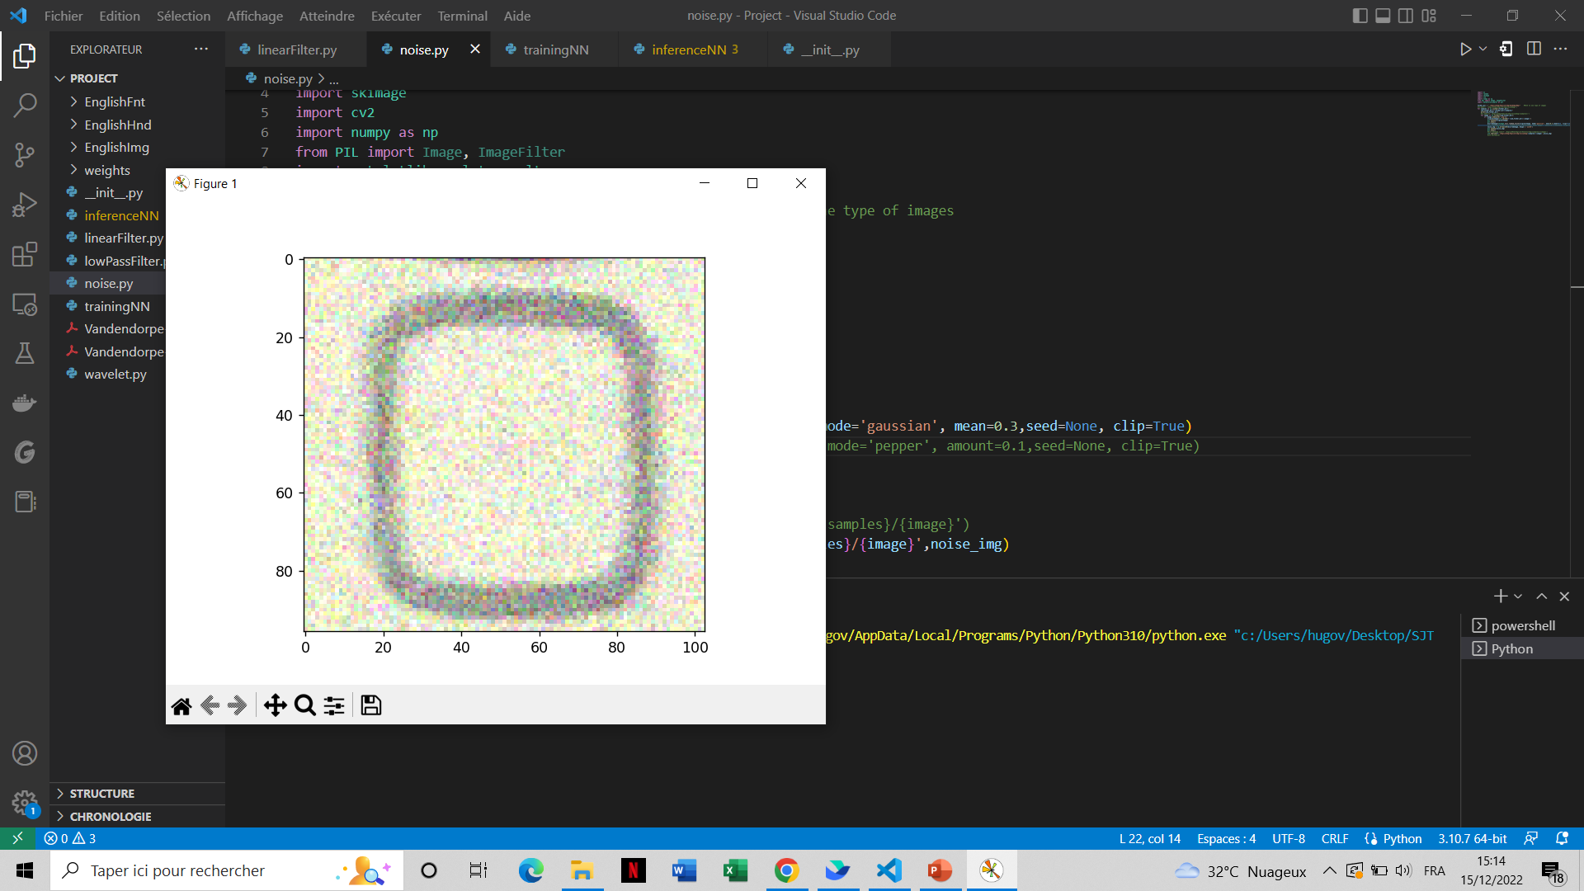
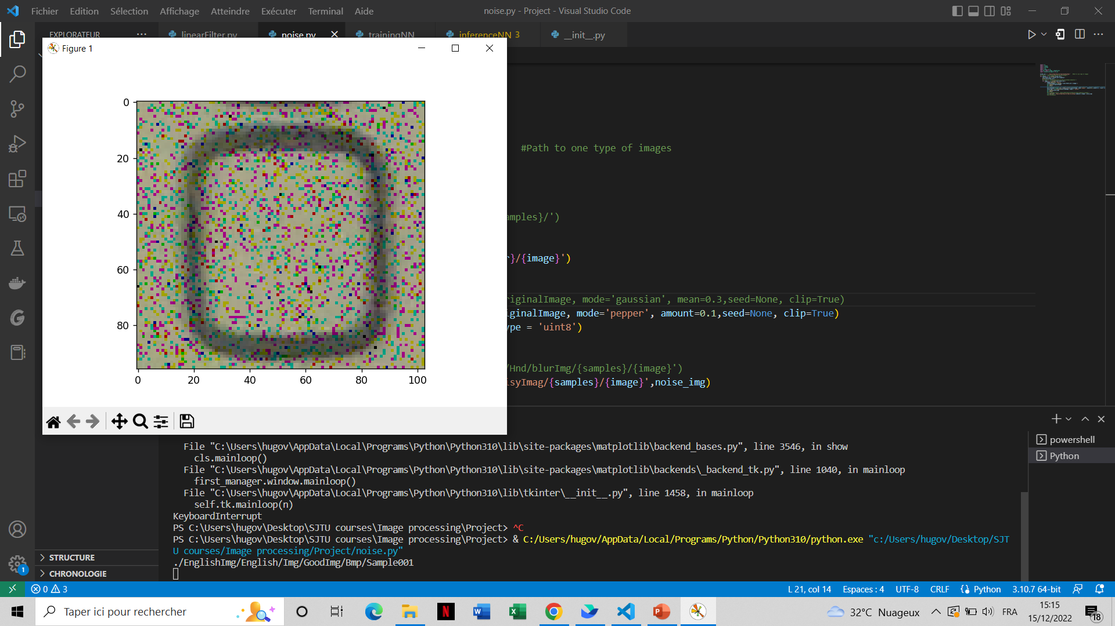
Add noise to images
Original image
Gaussian noise
Mean=0.3
Pepper noise
Amount=0,1

Slide 10

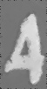
spatial Filters
Linear filter
Median filter
Convolve image with NxM matrix
Notre public cible est la génération Z (18-25 ans)
Original noisy image
Denoised image (median filter)

Slide 11
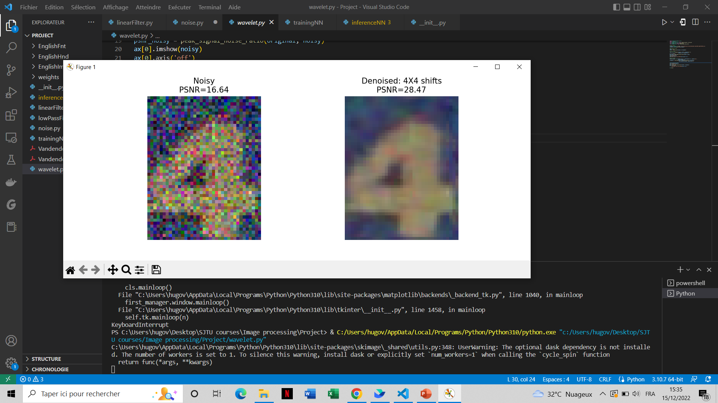
Transform domain filtering
Spatial frequency filtering
Original noisy image
Apply Low pass filter using fast fourier transform
The noise is removed by deciding a cut-off frequency and adapting a frequency domain filter
Wavelet domain filtering
Apply DWT to get small number of coefficients having high Signal to Noise Ratio (SNR)
Remove the coefficients with low SNR
Apply inverse DWT
Denoised image (wavelet transform)

Slide 12
Results

Slide 13
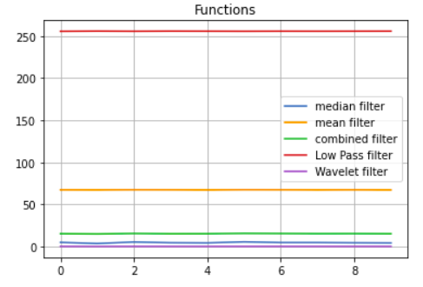
Metrics results
Error results
Error graph results for NRMSE
Error results
 | Mean | Median | Frequency | Wavelet
RMSE | 64,33 | 1 | 244,32 | 24,1
NRMSE | 67,37 | 4,64 | 255,87 | 0,099
SNR | 36,57 | 13,27 | 48,16 | -20,14
PSNR | 11,96 | 35,26 | 0,37 | 20,55

Slide 14
DNN Deep Neural Network
76 %
73 %
71 %
XX %
No noise added
Linear Filter
Median Filter
Spatial frequency filtering

Slide 15
Further work

Slide 16
Improvements
CNN denoising
Use more types of noises
Combine more types of methods

Slide 17
References
[1] Shyam G. Dafe and Shubham S. Chavhan. Optical Character Recognition Using Image Processing. 2018. url: https://www.irjet.net/archives/V5/i3/IRJET-V5I3218.pdf.
[2] Linwei Fan,Fan Zhang,Hui Fan and Caiming Zhang. “Brief review of image denoising techniques”. In: (2019). url: https://vciba.springeropen.com/articles/10.1186/s42492-019-0016-7
[3] Raghunath Dey,Rakesh Chandra Balabantaray,Surajit Mohanty, Debabrata Singh, Marimuthu Karuppiah, and Debabrata Samanta. “Approach for Preprocessing in Offline Optical Character Recognition (OCR)”. In: (2022). url: https://ieeexplore.ieee.org/document/9791698/authors#authors..

Slide 18
Comparaison des marchés
3 Mds €
2 Mds €
1 Md €
Opportunité de créer
Liberté de création
Faible concurrence
Marché potentiel
Segment de marché
Part de marché

